Slide 1

A New Input Grouping and Sharing Method to Design Low Complexity 32 - Point FFT Implementation
Presented by :
V. Venu (22481A04N9)
Saniya begum (22481A04L3)
Y. Gopal Krishna (22481A04P2)
R. Varshitha (22481A04L1)
Batch No: 12
Guide: Dr. V. V. K. D. V. Prasad, M. Tech, PhD (Professor & Convener (IQAC))
Department of Electronics and Communication Engineering
Seshadri Rao Gudlavalleru Engineering College

Slide 2
Contents
Abstract
Project Objectives
Block Diagram
Software
Project Implementation
Results
Applications & Advantages
Status of Publication
Conclusion & Future Scope
References

Slide 3
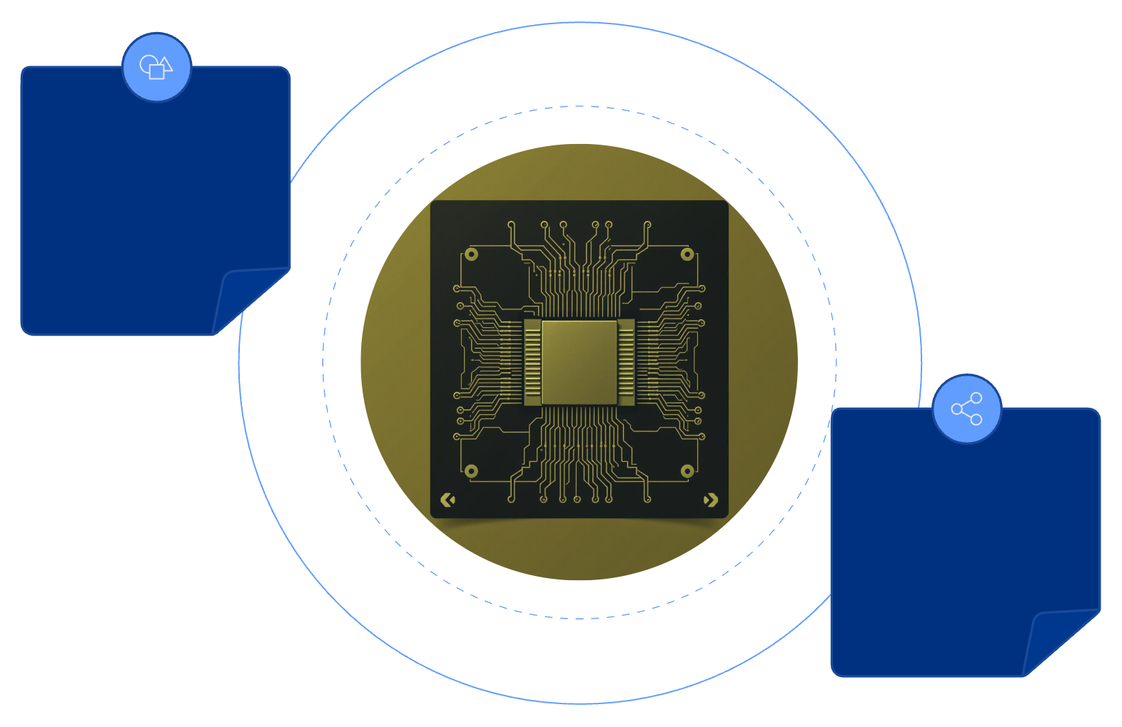


Abstract
The Fast Fourier Transform (FFT) is a widely applied algorithm in digital signal processing and communication systems. This brief introduces a novel low-power and low-complexity FFT architecture. An input grouping method is adopted to minimize the number of multiplications involving inputs and FFT twiddle factor coefficients. Additionally, a partial sum sharing scheme is proposed to efficiently reuse hardware resources, significantly reducing adder costs. Logic synthesis results on ASIC demonstrate that the proposed 32-point FFT architecture.
Input Grouping
Reduces input-twiddle multiplications
Partial Sum Sharing
Reuses hardware to cut adder costs

Slide 4




Project Objectives
Reduce Multiplications
Minimise Adder Usage
Minimise input × twiddle multiplications using input grouping.
1
2
Reduce adder count through partial sum sharing.
FPGA Implementation
Achieve Low-Complexity
FFT
Implement this project in Xilinx Vivado on Artix-7 FPGA board
4
3
Design a high-speed, low
complexity 32-point FFT architecture.

Slide 5
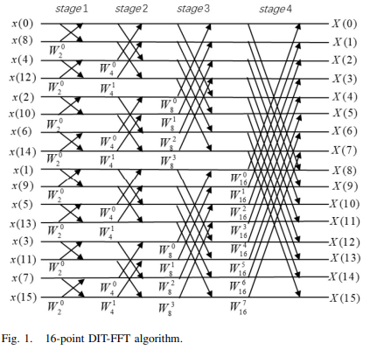
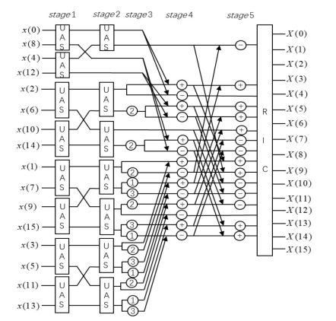
Block Diagram
Input Data
Input Grouping
Partial sum sharing
Butterfly stages
Twiddle Factor processing
FFT Output
Simulation
&
Analysis
Normal FFT The Proposed 16-Point Architecture

Slide 6
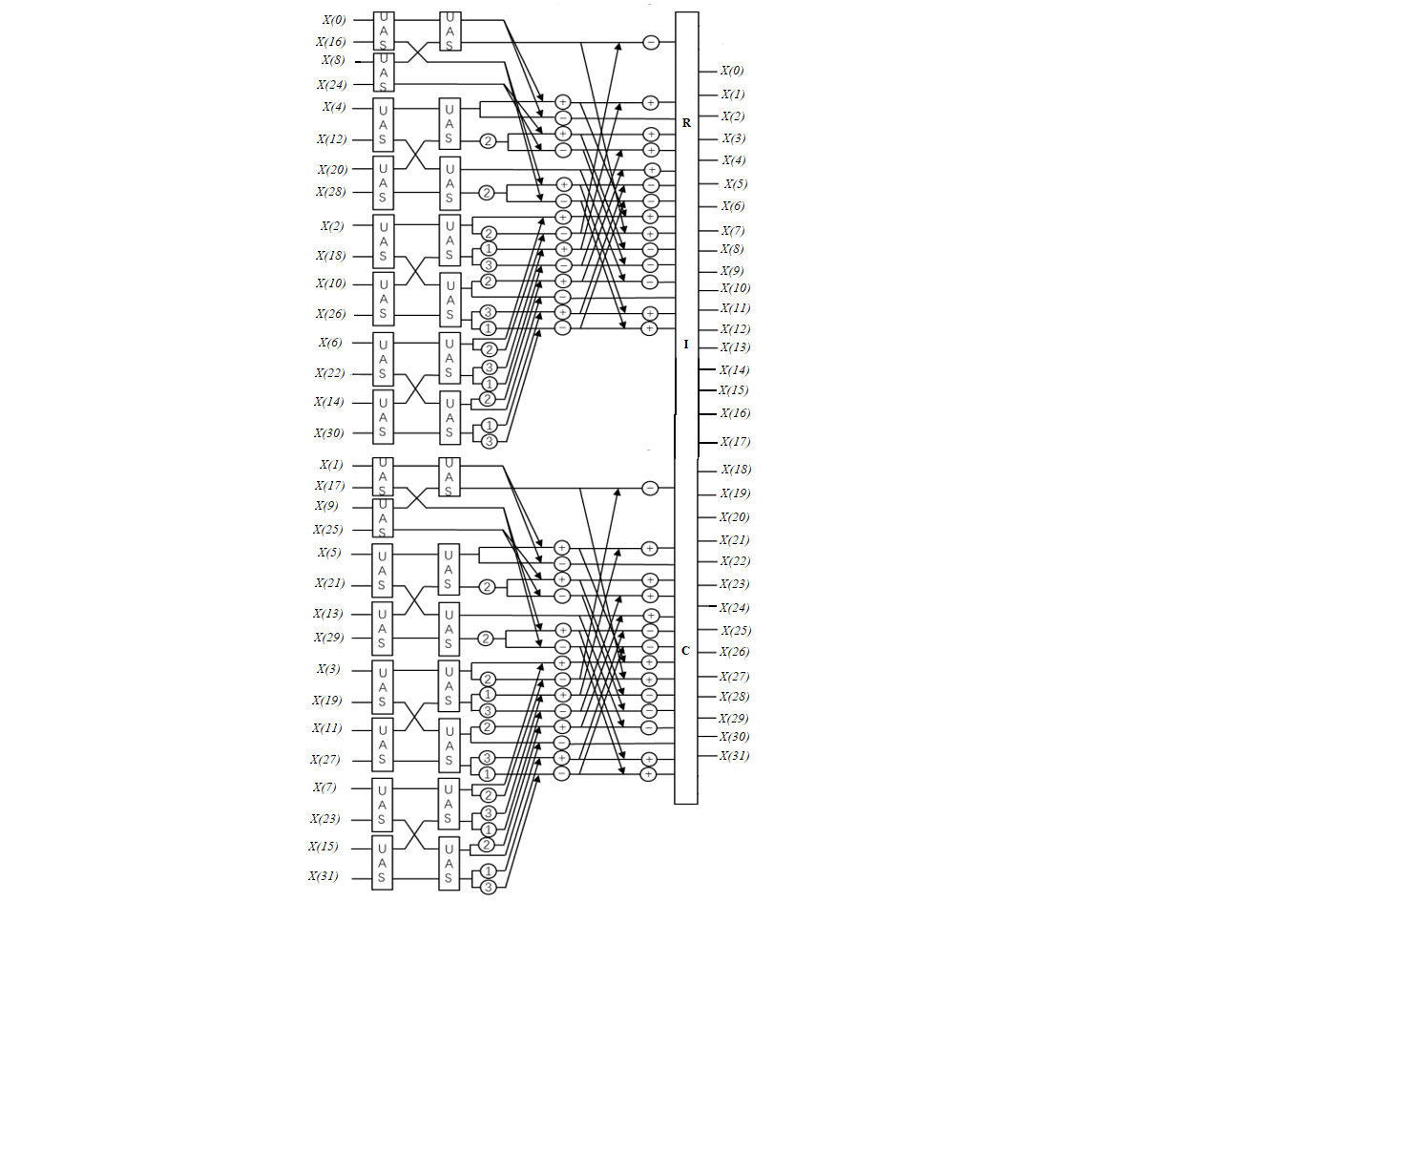
Project Implementation
Proposed Method
The Fast Fourier Transform (FFT) is an efficient algorithm used to compute the Discrete Fourier Transform (DFT). In essence, FFT transforms a signal from the time domain into the frequency domain, allowing us to analyze the frequency components of the signal. The 32-point FFT refers to the process of transforming 32 data points from the time domain to the frequency domain.
The Proposed 32- point Architecture

Slide 7
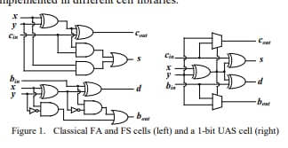
Input Data (X(0) to X(31):
The 32 input data points, labeled X(0) to X(31), represent the sampled time-domain values of the signal that is being analyzed. Each of these values corresponds to a specific time sample of a continuous signal, typically representing an audio signal, sensor data, or any discrete-time series data.
UAS Units in the Architecture:
The UAS (likely a logic unit or block) shown in the diagram is used for performing specific operations on the input data. In the context of FFT, UAS could represent an arithmetic or data manipulation unit that performs addition, subtraction, or complex multiplication operations. These operations are essential for combining input data points in the butterfly structure of the FFT.

Slide 8
Partial Sum Sharing:
The partial sum sharing technique improves efficiency by reusing intermediate results instead of recalculating them. This reduces redundant operations, lowers the number of adders, and saves hardware resources in the FFT design.
Butterfly Structure:
One of the fundamental aspects of the FFT algorithm is its use of the butterfly structure. This structure combines pairs of data points in each stage of the FFT computation. Each stage involves computing complex values (real and imaginary parts) for each pair, with the outputs being passed on to the next stage. The butterfly operation helps in reducing the computational complexity from O(N^2) to O(N log N).
Stages of FFT:
The FFT is typically computed in a series of stages, each one reducing the problem size. For a 32-point FFT, there are 5 stages, as log2(32) = 5. Each stage involves the pairing of data points and applying the butterfly operation to reduce the total number of computations required.

Slide 9
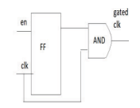
Twiddle Factor:
One of the key components of the FFT is the use of twiddle factors—complex exponential terms that are used to scale the data during the butterfly operations. These factors help in rotating the data in the complex plane, which is an essential part of transforming the data from the time domain to the frequency domain.
Flip-flop-based clock gating :
Flip-flop-based clock gating is a low-power technique used to reduce dynamic power consumption in digital circuits by disabling the clock when the system is idle. In this method, the enable signal is sampled using a D flip-flop on the rising edge of the clock, and the flip-flop output is ANDed with the clock to generate a gated clock. This ensures that clock transitions occur only at well-defined edges, preventing glitches and timing issues. When the enable signal is low, the gated clock remains off, reducing unnecessary switching activity. Compared to latch-based clock gating, this approach provides glitch-free operation, better timing closure, and easier integration in FPGA and ASIC designs.
Flip-flop-based clock gating technique

Slide 10
Real, Imaginary, and Complex Outputs:
The diagram shows outputs labeled R, I, and C. These correspond to the real and imaginary parts of the FFT results. R is the real component, I is the imaginary component, and C represents the combined complex values. These outputs are essential for fully representing the frequency components of the signal.
Functional Modules of the Design
Without Clock Gating
mux 2to1
UAS
Top_16
Top_32
With Clock Gating
flipflop_based_clk
mux 2to1
UAS
Top_16
Top_32
Test Bench for Verification
Test Bench for Verification
Tb_top_32
Top_tb

Slide 11
Software & Hardware Details
Software
Vivado 2020.3: For HDL simulation & synthesis.
FPGA Family : Artix - 7
Device: XC7A200TFBG676-2
Package: FBG676
Speed Grade: -2

Slide 12
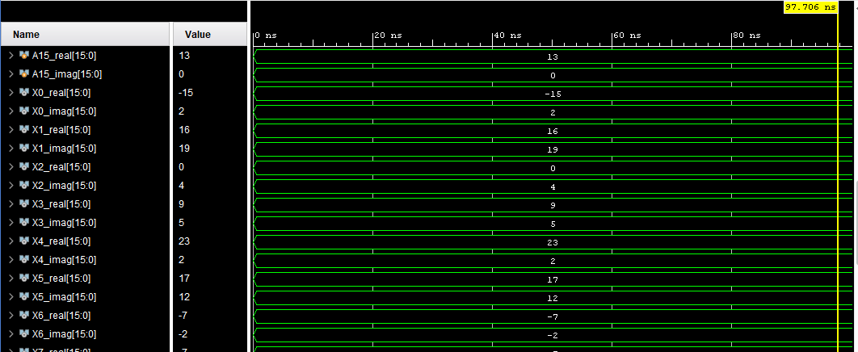
Results
Base Results: The Proposed 32-Point Architecture Without Clock Gating
Simulation Waveform

Slide 13
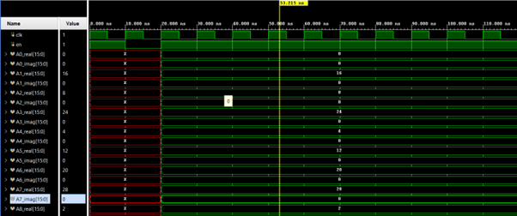
Extention Results: The Proposed 32-Point Architecture With Clock Gating
Simulation Waveform

Slide 14
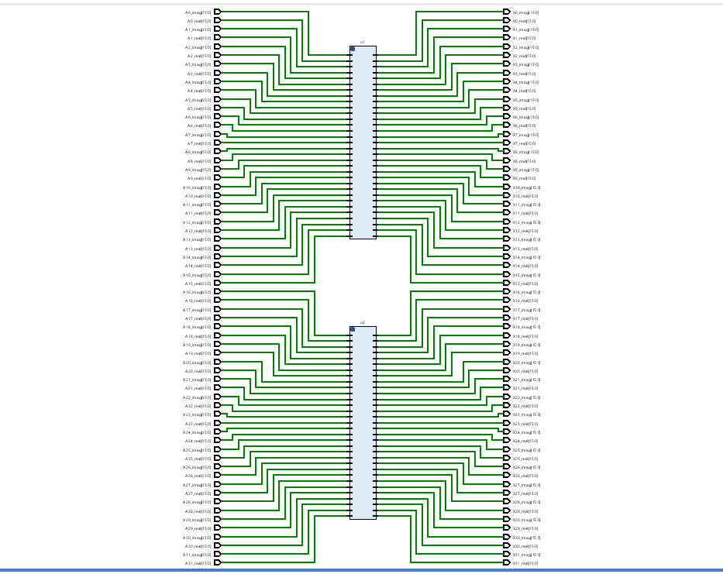
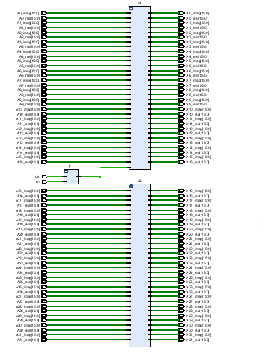
RTL Schematic of Without Clock
RTL Schematic of Without Clock

Slide 15
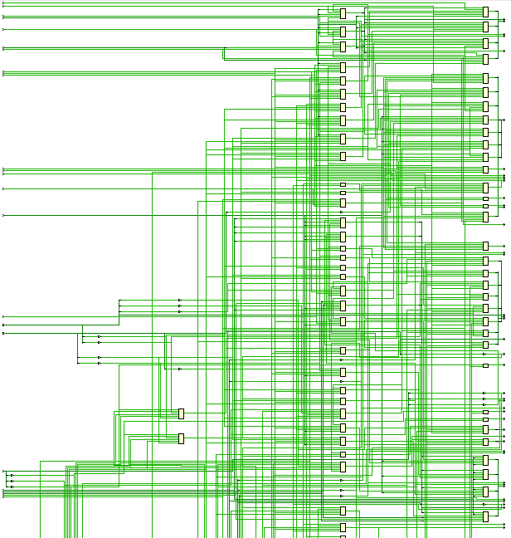
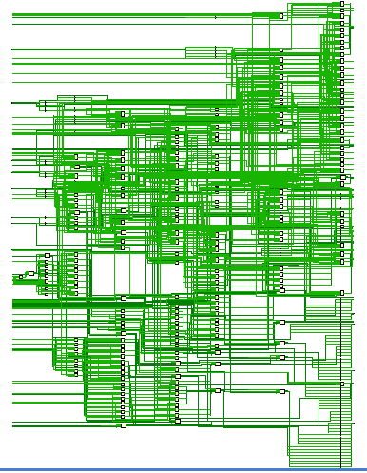
Technology Schematic Without Clock Gating
Technology Schematic With Clock Gating

Slide 16
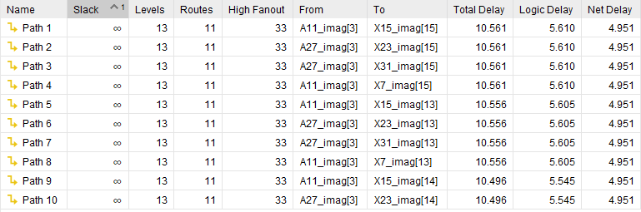
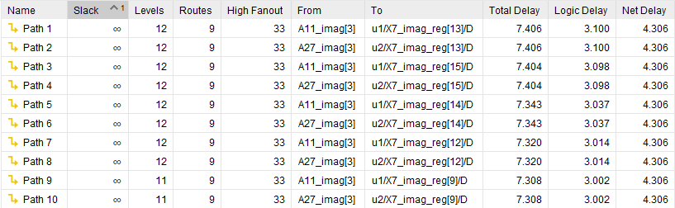
Delay Analysis
Without Clock Gating
Without Clock Gating
With Clock Gating

Slide 17

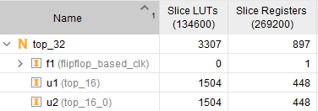
Area Utilization
Without Clock Gating
With Clock Gating

Slide 18
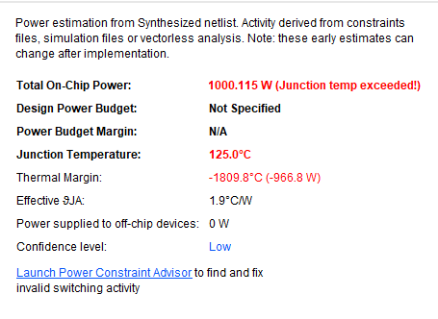
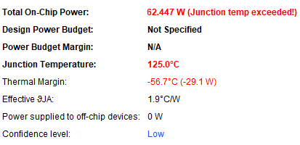
Power Consumption
Without Clock Gating
With Clock Gating

Slide 19
Comparative Analysis of 32-Point FFT With and without Clock Gating:
SI.NO | METHOD | AREA (LUT) | POWER(w) | DELAY(ns)
1 | WITHOUT CLOCK | 3290 | 1000.115 | 10.561
2 | WITH CLOCK | 3307 | 62.447 | 7.406

Slide 20
Results Summary
The base paper 16-point FFT architecture was successfully designed and functionally verified.
Using the validated 16-point FFT as a building block, the 32-point FFT architecture was successfully designed and implemented.
The proposed FFT architecture was designed and simulated using Xilinx Vivado.
The target hardware platform for implementation is the Artix-7 FPGA board.
Functional verification was completed successfully through simulation.
Performance evaluation was carried out in terms of area, power, and time delay.
The obtained results show a reduction in area, power, and delay compared to the conventional FFT architecture.
The obtained results show a reduction in area and time delay. however, power consumption increased compared to the conventional FFT architecture due to parallel processing of two 16-point FFT blocks.
To address this issue, A clock gating technique was implemented to reduce unnecessary switching activity, resulting in lower power consumption and delay. However, a slight increase in area occurred due to additional flip-flops and control logic.

Slide 21
Applications & Advantages
Applications
Mobile Communications (4G/5G Networks)
Wireless Local Area Networks (WLANs)
Signal Processing in IoT Devices
Image and Video Processing
Medical Imaging
Audio Processing
Advantages
Reduced Computational Complexity
Lower Hardware Resource Consumption
Improved Power Efficiency
Enhanced Processing Speed

Slide 22

Status of Project Publication
The research paper based on this project has been successfully submitted to i-Manager Publications and is currently under the review stage.

Slide 23
Conclusion & Future Scope
Conclusion:
The Fast Fourier Transform (FFT) plays a crucial role in digital signal processing and communication systems, but traditional implementations can be resource-intensive. This brief presents a novel low-power, low-complexity FFT architecture that leverages an innovative input grouping method to minimize multiplications involving inputs and FFT twiddle factors. Additionally, a partial sum sharing scheme is introduced to efficiently reuse hardware resources, significantly lowering adder costs. Logic synthesis results on ASIC demonstrate the effectiveness of the proposed 32-point FFT architecture, showcasing reduced hardware complexity and power consumption while maintaining performance. The approach offers significant advantages for applications in communication systems, embedded devices, and other resource-constrained environments
Future Scope:
The current project focuses on the design of a low-complexity FFT architecture at the hardware level, and in future, this work can be extended to develop real-time application-level systems by integrating the proposed FFT architecture into practical applications such as wireless communication, signal processing, FPGA-based embedded systems, IoT devices, and multimedia processing systems.

Slide 24
References
S. Wang and J. Chen, “A new input grouping and sharing method to design low complexity FFT implementation,” IEEE Transactions on Circuits and Systems Feb. 2024
P. K. Daram and C.-I. H. Chen, “Smart FFT measurement for reconfigurable sensor using a wideband digital receiver,” in Proc. IEEE Nat. Aerosp. Electron. Conf., Aug. 2021, pp. 200–203
N. Lei and X. Gu, “FFT-OT: A fast algorithm for optimal transportation,” in Proc. IEEE/CVF ICCV, Oct. 2021, pp. 6260–6269
Documentation: Xilinx Vivado User Guide.

